Slide 1
3 : Data Modeling using the
Entity-Relationship Model (6 Hrs)
Using High Level Conceptual Data Models for Database Design;
Entity Types, Entity Sets, Attributes, and keys; Relationship Types, Relationship Sets, Roles and Structure Constraints;
Weak Entity Types; ER Diagrams, Naming Conventions and Design Issues; Relationship Types of degree higher than two;
Subclasses, Superclasses and Inheritance; Specialization and Generalization; Constraints and Characteristics of Specialization and Generalization

Slide 2
Introduction
The entity-relationship (E-R) model is a high-level data model based on the perception of a real world that consists of a collection of basic objects, called entities and relationships among these entities.
An entity is a thing or object in the real world that is distinguishable from other objects.
A relationship is an association among several entities.
Entities are described by a set of attributes.
The set of all entities of the same type is called an entity set and the set of all relationships of the same type is called a relationship set.
In this model, we use E-R diagrams to express overall logical structure of the database.

Slide 3
Basic Concepts
The E-R model employs three basic notations: entity sets, relationship sets, and attributes.
Entity Sets:
  An entity is a thing or object in the real world that is distinguishable from all other objects. For example, specific person, company, event, plant etc.
  An entity has a set of properties called attributes, and the values for some set of properties may uniquely identify an entity. For example, people have names and addresses as attributes.
  An attribute of an entity type for which each entity must have a unique value is called a key attribute of the entity type.
    For example, SSN of EMPLOYEE.
  Entities with the same basic attributes are grouped or typed into an entity type.
  An entity type describes the schema or intension for a set of entities that share the same structure.
    For example, the entity type EMPLOYEE and PROJECT.

Slide 4
Basic Concepts
The collection of all entities of a particular entity type in the database at any point in time is called entity set,
The entity set is usually referred to using the same name as the entity type.
For example, EMPLOYEE refers to both a type of entity as well as the current set of all employees entities in the database.
An entity type is represented in ER diagrams as a rectangular box enclosing the entity type name.
Attribute names are enclosed in ovals and are attached to their entity type by straight lines.
Composite attributes are attached to their component attributes by straight lines.
Multivalued attributes are displayed in double ovals.

Slide 5
Basic Concepts
Key Attributes of an Entity Type: An important constraint on the entities of an entity is the key or uniqueness constraint on attributes.
An entity type usually has one or more attributes whose values are distinct for each individual entity in the entity set. Such as attribute is called a key attribute.
For example, Name attribute is a key attribute of the COMPANY entity type because no two companies are allowed to have the same name.
For the PERSON entity type, a typical key attribute is ssn (social security number). This attribute is underlined inside the oval.

Slide 6
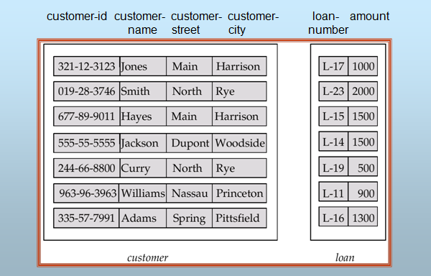
Basic Concepts
Fig: Entity sets customer and loan

Slide 7
Basic Concepts
Attributes:
  An entity is represented by a set of attributes. For example, a customer entity can have customer-id, customer-name, customer-street, and customer-city as attributes.
  Attributes are the descriptive properties possessed by all members of an entity set. Each entity may have its own value for each attribute.
  For each attribute, there is a set of permitted values, called the domain or value set of that attribute.
  The E-R model uses the different types of attributes.
  Simple and Composite Attributes:
    Simple attributes cannot be divided into subparts. For example, gender.
    Composite attributes on the other hand can be divided into subparts; that is, other attributes. A composite attribute may appear as hierarchy. For example, name, address etc.

Slide 8

Basic Concepts
Fig: Composite attributes

Slide 9
Basic Concepts
  Single-valued and Multi-valued Attributes:
    An attribute having a single value for a particular entity is called the single-valued attribute. For example, gender.
    An attribute having a set of values for a particular entity is called the multi-valued attribute. For example, phone-numbers.
  Derived Attributes:
    The value of the derived attributes can be computed from other attributes. For example, age, given date-of-birth.
  All attributes take a null value when an entity does not have a value for it. The null value may indicate “not applicable”, that is, the value does not exist for the entity.

Slide 10
Basic Concepts
Relationship Sets:
  A relationship is an association among several entities.
  A relationship set is a set of relationships of the same type.
  Formally, it is a mathematical relation on n ≥ 2 entity sets. If E₁, E₂,…, E_{n} are entity sets, then a relationship set R is a subset of {(e₁, e₂,…, e_{n})|e₁∈E₁, e₂∈E₂,…, e_{n}∈E_{n}}, where (e₁, e₂,….., e_{n}) is a relationship. For example, (Hayes, L-15) ∈ borrower relationship set.
  The association between entity sets is referred to as participation, that is, the entity sets E₁, E₂,…., E_{n} participate in relationship set R.
  A relationship instance represents an association between the named entities.

Slide 11
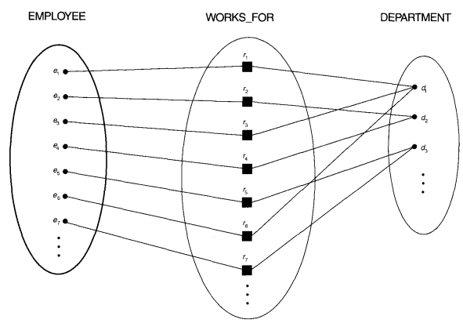
Figure: Some instances in WORKS_FOR relationship set, which represents relationship type WORKS_FOR between EMPLOYEE and DEPARTMENT

Slide 12

Basic Concepts
Fig: Relationship set borrower

Slide 13
Attributes of Relationship Type
  A relationship types can also have attributes, similar to those of entity types. for example, to record the number of hours per week that a particular employee works on a particular project, we can include an attribute Hours for WORKS_ON relationship type (next slide).
  The attributes of 1:1 relationship type can be migrated to one of the participating entity type.
  For a 1:N relationship type, a relationship attribute can be migrated to only to the entity type on the N side of the relationship
  For N:M relationship types, some attributes may be determined by the combination of participating entities in a relationship instance, not only any single entity. Such attributes may be specified as relationship attributes. An example is the Hours attribute of the M:N relationship WORKS_ON(slide 13); the number of hours per week an employee currently works on a project is determined by an employee-project combination and not separately by either entity.

Slide 14

Basic Concepts
Fig: Descriptive attribute

Slide 15
Basic Concepts
  There can be more than one relationship set involving the same entity set.
  Degree of a relationship set refers to the number of entity sets that participate in a relationship set.
  Relationship sets that involve two entity sets are called binary relationship sets. Most relationship sets in a database system are binary.
  Relationship sets may involve more than two entity sets called n-ary relationship sets but are rare. For example, suppose employees of a bank may have jobs (responsibilities) at multiple branches, with different jobs at different branches. Then there is a ternary relationship set between entity sets employee, job and branch.

Slide 16
Role Names and Recursive Relationships
  Each entity type that participates in a relationship type plays a particular role in the relationship.
  The function that an entity plays in a relationship is called that entity’s role.
  The role name signifies the role that a particular entity from the entity type plays in each relationship instance, and helps to explain what the relationship means.
  In case of distinct entity sets participating in a relationship set, roles are implicit and are not usually specified.
  When the entity sets of a relationship set are not distinct; that is, the same entity set participates in a relationship set more than once, in different roles, explicit role names are necessary to specify how an entity participates in a relationship instance.
  This type of relationship set is sometimes called a recursive relationship set or self-referencing referencing relationships

Slide 17
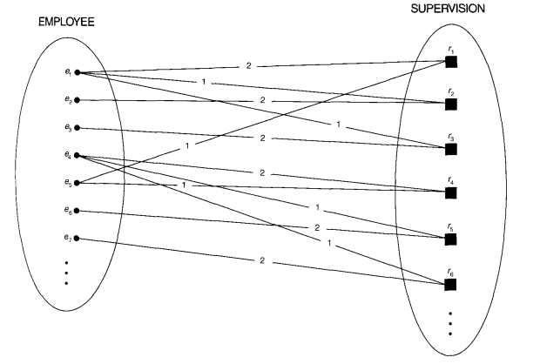
Role Names and Recursive Relationships
Figure: A recursive relationship SUPERSION
between EMPLOYEE in the supervisor role (1)
And EMPLOYEE in the subordinate role(2)

Slide 18
Constraints on Binary Relationship Types
Relationship types usually have certain constraints that limit the possible combinations of entities that may participate in the corresponding relationship set.
These constraints are determined from the miniworld situation that the relationships represent. For example, if the company has a rule that each employee must work for exactly one department, then we would like to describe this constraint in the schema.
We can distinguish two main types of binary relationship constraints: cardinality ratio and participation constraints

Slide 19
Cardinality Ratios for Binary Relationships
Mapping Cardinalities: The cardinality ratio for a binary relationship specifies the maximum number of relationship instances that an entity can participate.
For example, in the WORKS_FOR binary relationship type, DEPARTMENT:EMPLOYEE is of cardinality ratio 1:N, meaning that each department can be related any number of employee (N)
  For binary relationship set R between entity sets A and B, there are four types of mapping cardinalities: one-to-one, one-to-many, many-to-one, and many-to-many.
  One to One: An entity in A is associated with at most one entity in B, and an entity in B is associated with at most one entity in A. For example, mapping cardinality between departments and chairpersons.

Slide 20
Constraints
  One to Many: An entity in A is associated with any number (zero or more) of entities in B. an entity in B, however, can be associated with at most one entity in A. For example, mapping cardinality between mothers and children.
  Many to One: An entity in A is associated with at most one entity in B. an entity in B, however, can be associated with any number (zero or more) of entities in A. For example, mapping cardinality between children and mothers.
  Many to Many: An entity in A is associated with any number (zero or more) of entities in B, and an entity in B is associated with any number (zero or more) of entities in A. For example, mapping cardinality between students and courses.

Slide 21
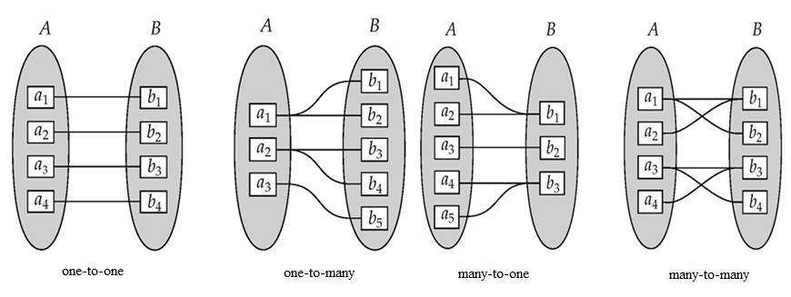
Constraints

Slide 22
Constraints
Participation Constraints:
  The participation of an entity set A in a relationship set R is said to be total if every entity in A participates in at least one relationship in R. For example, consider customer and account entity sets in a banking system, and a relationship set depositor between them indicating that each customer must have an account. Then there is total participation of entity set customer in the relationship set depositor.
  If only some entities in A participate in relationships in R, the participation of entity set A in relationship set R is said to be partial. For example, consider customer and loan entity sets in a banking system, and a relationship set borrower between them indicating that some customers have loans. Then there is partial participation of entity set customer in the relationship set borrower.

Slide 23
Keys
Keys are used to distinguish the entities within a given entity set. Furthermore, a key allows us to identify a set of attributes that suffice to distinguish entities from each other. Keys also help to uniquely identify relationships.
Keys for Entity Sets:
  A super-key of an entity set is a set of one or more attributes whose values uniquely determine each entity. Any superset of a super-key is also a super-key.
  A super-key may also contain extraneous attributes. A candidate key of an entity set is a minimal super-key; that is, super-key for which no proper subset is a super-key. For example, customer-id is candidate key of customer entity set.
  An entity set may have several candidate keys. We use the term primary key to denote a candidate key that is chosen by the database designer for identifying entities within an entity set.

Slide 24
Keys
  Alternate keys are the remaining candidate keys other than primary key.
  So, there is always one and only one primary key in an entity set. A primary key of an entity set allows us to distinguish among various entities of the set.
Keys for Relationship Sets:
  The combination of primary keys of the participating entity sets forms a super-key for the relationship set. For example, (customer-id, account-number) is the super key of depositor relationship set.
  Let R be a relationship set involving entities E₁, E₂,……, E_{n}. Let primary-key (E_{i}) denotes the set of attributes that forms the primary key for entity set E_{i}. Assume that the attribute names of all primary keys are unique, and each entity set participates only once in the relationship. The super key for the relationship set can be defined as
  primary-key (E₁)U primary-key (E₂)U……U primary-key (E_{n})

Slide 25
Entity-Relationship Diagram
An E-R diagram expresses the overall logical structure of a database graphically. E-R diagram consists of the following major components:
  Rectangles represent entity sets.
  Diamonds represent relationship sets.
  Lines link attributes to entity sets and entity sets to relationship sets.
  Ellipses represent attributes
  Double ellipses represent multi-valued attributes.
  Dashed ellipses denote derived attributes.
  Underline indicates primary key attributes
  Double Lines indicate total participation of an entity set in a relationship set.
  Double Rectangles represent weak entity sets.
  Double Diamonds represent identifying relationship sets.

Slide 26

Entity-Relationship Diagram
Fig: E-R diagram with composite, multivalued, and derived attributes

Slide 27

Entity-Relationship Diagram
Fig: E-R diagram corresponding to customers and loans
To distinguish the type of the relationships, we draw either a directed line (→) or an undirected line (⎯) between the relationship set and the entity set. Directed line indicates one and undirected line indicates many.
Hence, the figure above has many-to-many relationship.

Slide 28

Entity-Relationship Diagram
One-to-one relationship: Suppose a customer is associated with at most one loan and a loan is associated with at most one customer via the relationship set borrower.

Slide 29
Entity-Relationship Diagram
One-to-many relationship: Suppose a loan is associated with at most one customer and a customer is associated with several (including 0) loans via borrower relationship set.

Slide 30
Entity-Relationship Diagram
One-to-many relationship: Suppose a loan is associated with several (including 0) customers and a customer is associated with at most one loan via borrower relationship set.

Slide 31

Entity-Relationship Diagram
If a relationship set has also some attributes associated with it, then we link these attributes to that relationship set.

Slide 32

Entity-Relationship Diagram
We indicate roles in an E-R diagram by labeling the lines that connect diamonds to rectangles.

Slide 33

Entity-Relationship Diagram
Double lines are used to indicate that the participation of an entity set in a relationship set is total; that is, each entity in the entity set occurs in at least one relationship in that relationship set.

Slide 34

Entity-Relationship Diagram
E-R diagram also provide a way to indicate more complex constraints on the number of times each entity participates in relationships in a relationship set. An edge between an entity set and a binary relationship set can have an associated minimum and maximum cardinality, shown in the form of L….H, where L is the minimum and H is maximum cardinality.

Slide 35

Entity-Relationship Diagram
Non-binary relationship sets can also be specified easily in an E-R diagram.

Slide 36

Alternative ER Notations:

Slide 37

Participation of an Entity Set in a Relationship Set
Total participation (indicated by double line): every entity in the entity set participates in at least one relationship in the relationship set
  E.g., participation of section in sec_course is total
    every section must have an associated course
Partial participation: some entities may not participate in any relationship in the relationship set
  Example: participation of instructor in advisor is partial

Slide 38

E-R Diagram with a Ternary Relationship

Slide 39
Weak Entity Sets
An entity set that does not have a primary key is referred to as a weak entity set.
The existence of a weak entity set depends on the existence of a identifying entity set
  It must relate to the identifying entity set via a total, one-to-many relationship set from the identifying to the weak entity set
  Identifying relationship depicted using a double diamond
The discriminator (or partial key) of a weak entity set is the set of attributes that distinguishes among all the entities of a weak entity set.
The primary key of a weak entity set is formed by the primary key of the strong entity set on which the weak entity set is existence dependent, plus the weak entity set’s discriminator.

Slide 40
Weak Entity Sets (Cont.)
We underline the discriminator of a weak entity set with a dashed line.
We put the identifying relationship of a weak entity in a double diamond.
Primary key for section – (course_id, sec_id, semester, year)

Slide 41
Weak Entity Sets (Cont.)
Note: the primary key of the strong entity set is not explicitly stored with the weak entity set, since it is implicit in the identifying relationship.
If course_id were explicitly stored, section could be made a strong entity, but then the relationship between section and course would be duplicated by an implicit relationship defined by the attribute course_id common to course and section

Slide 42

Entity-Relationship Diagram
  In the figure below, payment-number is partial key and (loan-number, payment-number) is primary key for payment entity set.

Slide 43

Relationship Sets with Attributes

Slide 44

Roles
Entity sets of a relationship need not be distinct
  Each occurrence of an entity set plays a “role” in the relationship
The labels “course_id” and “prereq_id” are called roles.
Another e.g. manager and worker role in “manages” relationship with the entity “employee”

Slide 45
Proper Naming of Schema Constructs
When designing a database, the choice of names for entity types, attributes, relationship types and (particularly) roles is not straightforward.
One should choose names that convey, as much as possible, the meanings attached to the different constructs in the schema.
We choose to use singular names (CAPITAL) for entity types, rather than plural ones, because the entity type name applies to each individual entity belonging to that entity type.

Slide 46

E-R Diagram for a University Enterprise

Slide 47
Proper Naming of Schema Constructs
We use the convention that entity type and relationship type names are in uppercase letters, attribute names have their initial names have their initial letters capitalized, and role names are in lowercase letters.
We use nouns to give name to entity type and verbs to give names to relationship types.
Attribute names generally arise from additional nouns that describe the nouns corresponding to entity types.
Another naming consideration involves choosing binary relationship names to make the ER diagram of the schema readable from left to right and top to bottom

Slide 48
Choosing between Binary and Ternary (or Higher Degree) Relationships
In general, a ternary relationship type represents different information than do three binary relationship types.
The existence of three relationship instances does not necessarily imply that an instance exists in ternary relationship.
It is often tricky to decide whether a particular relationship should be represented as relationship type of degree n or should be broken down into several relationship types of smaller degrees.
The designer must base this decision on the semantics or meaning of the particular situation being represented.
If the connection can be reasonably broken down into separate binary relationships, using those might be simpler and more efficient.
Ternary relationships can become complex to manage and query in databases. If possible, represent the scenario with simpler binary relationships.
The typical solution is to include the ternary relationship plus one or more of the binary relationships, if they represent different meanings and if all are needed by the application

Slide 49
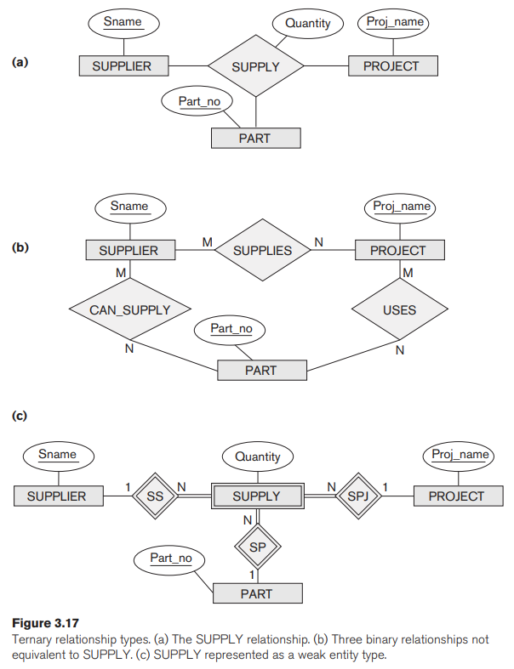
1-<number>

Slide 50
Introduction to Extended E-R Model(EER Model)
As the complexity of data increases in the late 1980s, it became more and more difficult to the traditional ER Model for database modeling.
Hence some improvement or enhancements were made to the existing ER Model, along with other improvements were made to the existing ER Model to make it able to handle the complex applications better.
Hence, as part of the Enhanced ER model, along with other improvements, three new concepts were added to the existing ER Model, they were
Subclasses and Super Classes
Specialization and Generalization
Category or union type
Aggregation

Slide 51
Features of EER Model
EER creates a design more accurate to database schemas.
It reflects the data properties and constraints more precisely.
It includes all modeling concepts of the ER model.
Diagrammatic technique helps for displaying the EER schema.
It includes the concept of specialization and generalization.
It is used to represent a collection of objects that is union of objects of different entity types.

Slide 52
EER(Extended ER) Modeling
It includes all of the modeling concepts of the ER model, in addition it includes the concepts of subclass and superclass and the related concepts of specialization and generalization.
Subclass and Superclass:
  An entity set may have a number of sub-groupings of its entities that are meaningful. Here, the entity set is called superclass while the subgroupings are known as subclasses of the superclass, that is, a subclass S is a class whose entities must always be a subset of the entities in another class, called superclass C.
  We call the relationship between a superclass and any one of its subclass a superlass /subclass or simply class/subclass relationship.
  An entity that is a member of subclass inherits all attributes from its superclass. That is, there is type inheritance in subclass. The entity also inherits all the relationships in which the superclass participates.

Slide 53
Subclasses, Super Classes and inheritance
Shape
super
d
Sub-classes
square
circle
triangle

Slide 54
EER(Extended ER Modeling)
Specialization:
  It is a top-down design process. Here, we define a set of subclasses of a given, superclass entity set.
  The set of sublcasses that form specialization is defined on the basis of some distinguishing characteristics of the entities in the superclass.
  Specialization is depicted by a triangle component labeled ISA. For example, customer “is a” person.
  The ISA relationship also referred to as superclass-subclass relationship.
  Here, a lower-level entity set inherits all the attributes and relationship participation of the higher-level entity set to which it is linked.
  The figure on the next slide shows specialization.

Slide 55

Fig: Specialization example

Slide 56
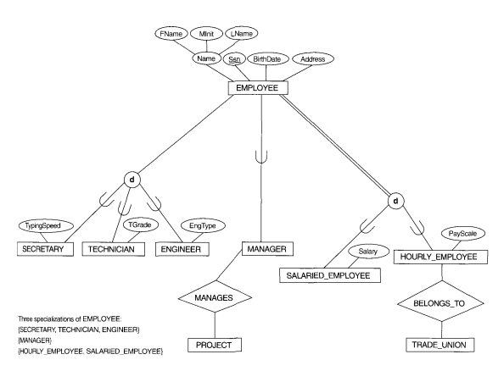
1-<number>

Slide 57
EER(Extended ER Modeling)
Generalization:
  It is a bottom-up design process. Here, we combine a number of entity sets that share the same features into a higher-level entity set.
  The original classes become the subclass of the newly formed generalized superclass.
  The reason, a designer applies generalization is to emphasize the similarities among the entity sets and hide their differences.
  Specialization and generalization are simple inversions of each other; they are represented in an E-R diagram in the same way.
  The terms specialization and generalization are used interchangeably.

Slide 58
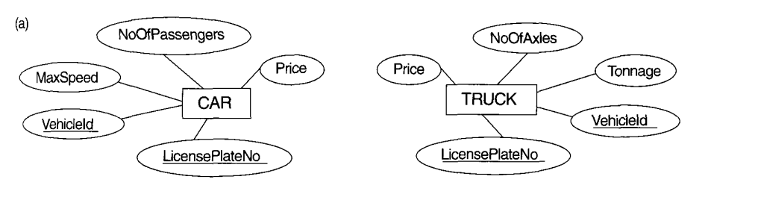
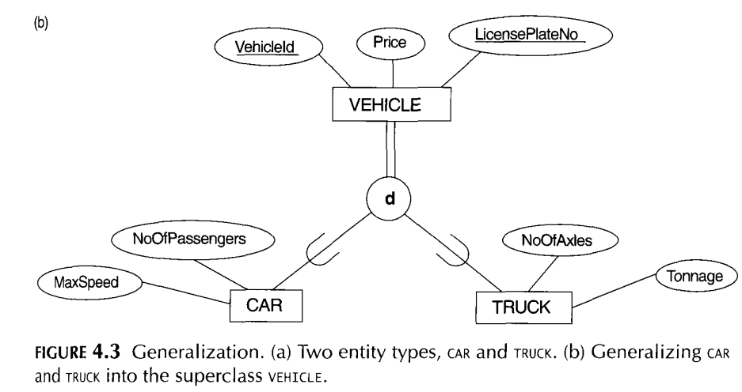

Slide 59
EER(Extended ER Modeling)
Design Constraints on Specialization/Generalization:
  Constraint on which entities can be members of a given lower-level entity set:
    Condition-defined: If we can determine exactly those entities that will become members of each subclass by a condition, the subclasses are called predicate-defined (or condition-defined) subclasses. Here, condition is a constraint that determines subclass members. For example, all customers over 65 years are members of senior-citizen entity set; senior-citizen ISA person.
    Attribute-defined: If all subclasses have membership condition on the same attribute of the superclass, it is called an attribute defined-subclass. And, the attribute is called the defining attribute.
    Example: JobType is the defining attribute of {SECRETARY, TECHNICIAN, ENGINEER} of EMPLOYEE.

Slide 60
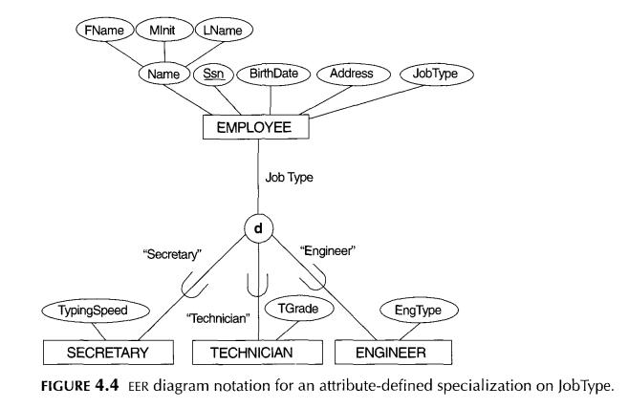
50

Slide 61
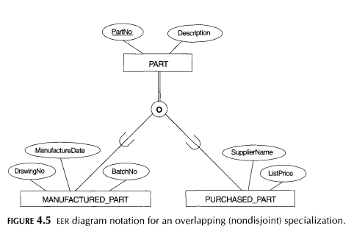

Slide 62
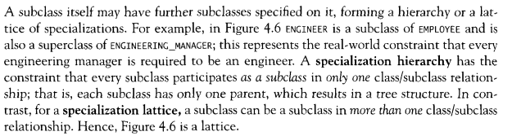
Specialization/Generalization Hierarchies and Lattices

Slide 63
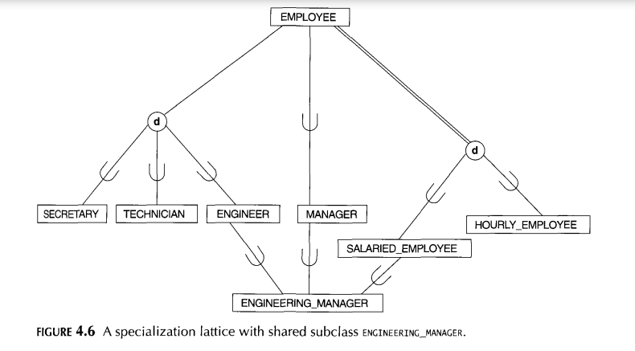

Slide 64
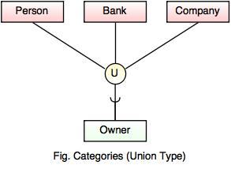
Category or Union
Category represents a single sub class relationship with more than one super class.
It can be a total or partial participation.
Here, the subclass will represent a collection of objects that is a subset of the union of distinct entity types; we call such a subclass a union type or a category.
For example Car booking, Car owner can be a person, a bank (holds a possession on a Car) or a company.
  Category (sub class) → Owner is a subset of the union of the three super classes → Company, Bank, and Person.
  A Category member must exist in at least one of its super classes.

Slide 65
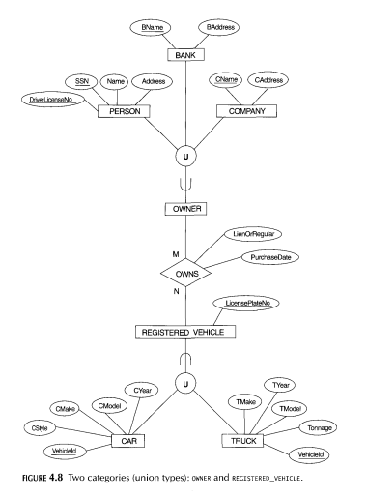

Slide 66
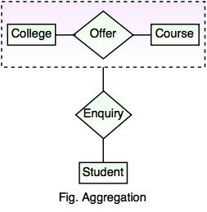
Aggregation
Aggregation is a process that represent a relationship between a whole object and its component parts.
It abstracts a relationship between objects and viewing the relationship as an object.
It is a process when two entity is treated as a single entity.
In given example, the relation between College and Course is acting as an Entity in Relation with Student.

Slide 67

EER(Extended ER Modeling)
Aggregation
  Aggregation is an abstraction through which relationship sets are treated as high-level entity sets and can participate in relationship sets.
  Allows relationships between relationships.

Slide 68
EER(Extended ER Modeling)
    User-defined: If no condition determines membership, the subclass is called user-defined. Membership in a subclass is determined by the database users by applying an operation to add an entity to the subclass. Membership in the subclass is specified individually for each entity by the user.
  Constraint on whether or not entities may belong to more than one lower-level entity set.
    Disjoint: An entity can belong to only one lower-level entity set. Noted in E-R diagram by writing disjoint next to the ISA triangle.
    Overlapping: An entity can belong to more than one lower-level entity set.
  Constraint that specifies whether or not an entity in the higher-level entity set must belong to at least one of the lower-level entity sets.
    Total : An entity must belong to one of the lower-level entity sets
    Partial: An entity need not belong to one of the lower-level entity sets.

Slide 69

Summary of Symbols in ER Diagram

Slide 70
Summary of Symbols in ER Diagram

Slide 71

Alternative ER Notations

Slide 72

Example: ER Diagram for Banking Enterprise

Slide 73
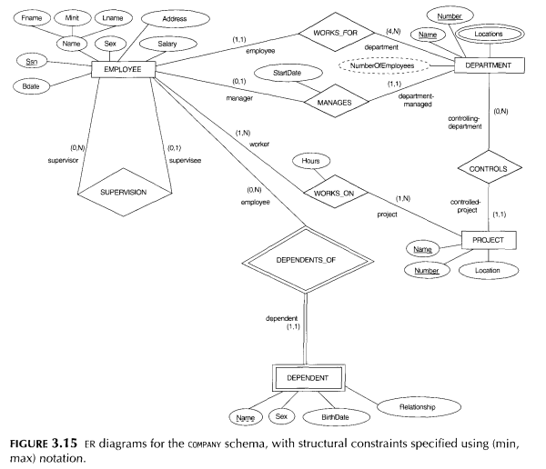
1-<number>

Slide 74
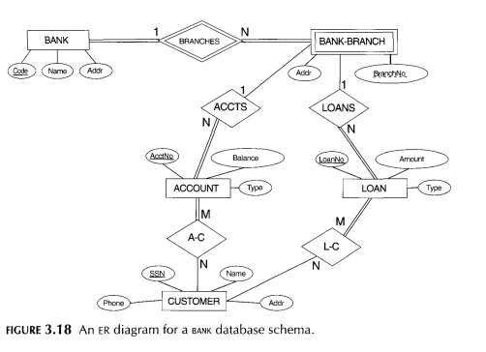
1-<number>

Slide 75
Exercises
Construct an ER diagram for a car-insurance company whose customers own one or more cars each. Each car has associated with it zero to any number of recorded accidents.
Construct an ER diagram for a hospital with a set of patients and a set of doctors. Associate with each patient a log of the various tests and examinations conducted.
Construct an ER diagram of the library system in your college.
Construct an ER diagram to maintain data about students, instructors, semester, and courses in a college.
Construct an ERD to record the marks that students get in different exams of different course offerings.
Define the following terms: entity, attribute, attribute value, relationship instance, composite attribute, multivalued attribute, derived attribute, com_x0002_plex attribute, key attribute, and value set (domain).

Slide 76
Exercise…
What is an entity type? What is an entity set? Explain the differences among an entity, an entity type, and an entity set.
What is a relationship type? Explain the differences among a relationship instance, a relationship type, and a relationship set.
When is the concept of a weak entity used in data modeling? Define the terms owner entity type, weak entity type, identifying relationship type, and partial key.
Describe the two alternatives for specifying structural constraints on relationship types. What are the advantages and disadvantages of each.
Discuss the role of a high-level data model in the database design process.
Explain the difference between an attribute and a value set.
Under what conditions can an attribute of a binary relationship type be migrated to become an attribute of one of the participating entity types?
1-<number>

Slide 77
Exercise…
What is a subclass? When is a subclass needed in data modeling?
Define the following terms: superclass of a subclass, superclass/subclass relationship, IS-A relationship, specialization, generalization, category, specific (local) attributes, and specific relationships.
Discuss user-defined and predicate-defined subclasses and identify the differences between the two.
What is the difference between a specialization hierarchy and a specialization lattice?
What is the difference between specialization and generalization? Why do we not display this difference in schema diagrams?
Discuss the two main types of constraints on specializations and generalizations.
Design an EER schema for a database application that you are interested in. Specify all constraints that should hold on the database. Make sure that the schema has at least five entity types, four relationship types, a weak entity type, a superclass/subclass relationship, a category, and an n-ary (n > 2) relationship type
1-<number>

